Slide 1
Quasirandom Sequences and Discrepancy
SWIM Princeton 2009
Keren Gu
Jenny Huang
Heidi Chen

Slide 2
Outline
Computer Generated Random Numbers
The Van Der Corput Numbers
The Halton Numbers
Discrepancy
Linear Congruence Generator

Slide 3
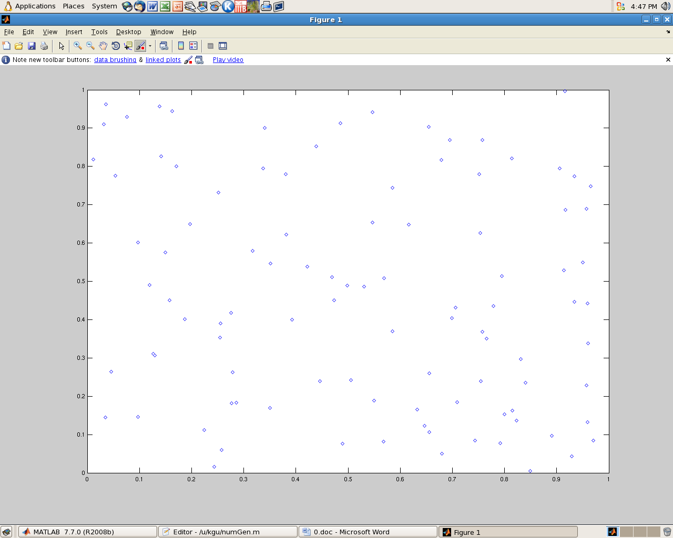
“Random” Numbers
100 Random Numbers Generated by MATLAB
Number of dots in the circle: 74
Area estimated: 0.74 Real area: 0.7854
Ratio between the two values: 0.9422 %Error: 5.78%

Slide 4
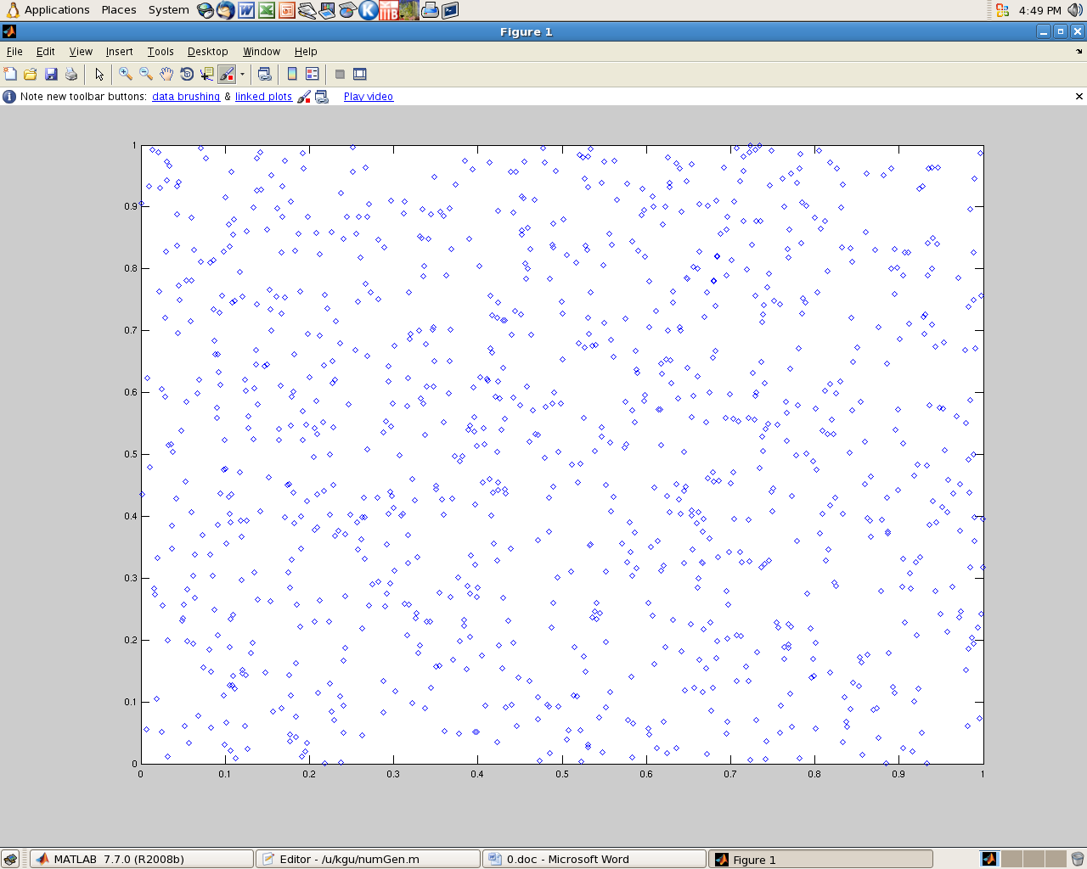
1000 Random Numbers generated by MATLAB
Number of dots in the circle: 802
Area estimated:0.802 Real area: 0.7854
Ratio: 1.0211 %Error: 2.11%

Slide 5
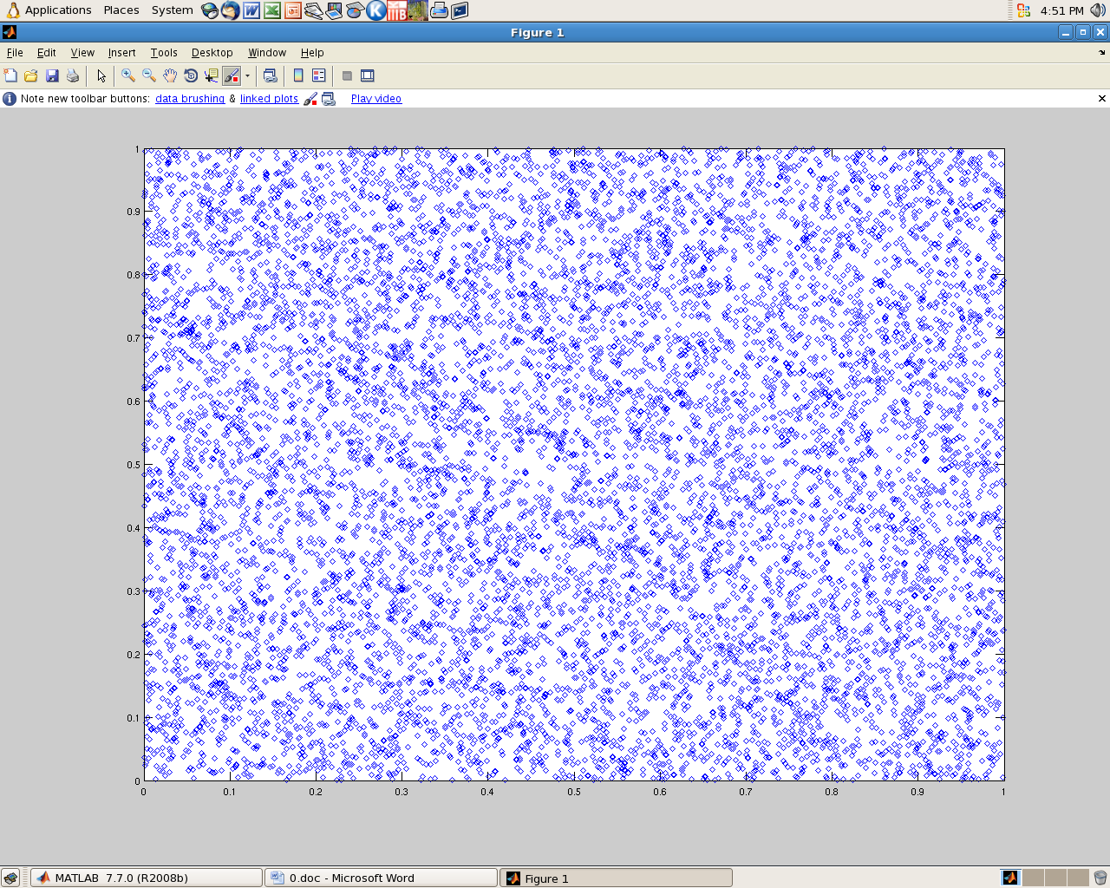
Random Numbers generated by MATLAB: 10000
Number of dots in the circle: 7828
Area estimated: 0.7828 Real area: 0.7854
Ratio: 0.9967 %Error: 0.33%

Slide 6
Conclusion
The estimation is precise to the 1000th place, however, these numbers are not random, and the graphs show clustered dots not equally distributed.

Slide 7
Van der Corput sequence
A van der Corput sequence is a low-discrepancy sequence over the unit interval first published in 1935 by the Dutch mathematician J. G. van der Corput. It is constructed by reversing the base n representation of the sequence of natural numbers (1, 2, 3, …). *
* http://en.wikipedia.org/wiki/Van_der_Corput_sequence

Slide 8
Van der Corput sequence
Example:13
In Base n (where n = 2): 1101
Reverse + Decimal: 0.1011
0.1011 (Base 2) = 0.8125
13 → 0.8125

Slide 9
#2) First 100 Van Der Corput Number Generated in Base two
0.0, 0.5, 0.25, 0.75, 0.125,
0.625, 0.375, 0.875, 0.0625, 0.5625, 0.3125, 0.8125, 0.1875, 0.6875, 0.4375, 0.9375, 0.03125, 0.53125, 0.28125, 0.78125, 0.15625, 0.65625, 0.40625, 0.90625, 0.09375, 0.59375, 0.34375, 0.84375, 0.21875, 0.71875, 0.46875, 0.96875, 0.015625, 0.515625, 0.265625, 0.765625, 0.140625, 0.640625, 0.390625, 0.890625, 0.078125, 0.578125, 0.328125, 0.828125, 0.203125, 0.703125, 0.453125, 0.953125, 0.046875, 0.546875, 0.296875, 0.796875, 0.171875, 0.671875, 0.421875, 0.921875, 0.109375, 0.609375, 0.359375, 0.859375, 0.234375, 0.734375, 0.484375, 0.984375, 0.0078125, 0.5078125, 0.2578125, 0.7578125, 0.1328125, 0.6328125, 0.3828125, 0.8828125, 0.0703125, 0.5703125, 0.3203125, 0.8203125, 0.1953125, 0.6953125, 0.4453125, 0.9453125, 0.0390625, 0.5390625, 0.2890625, 0.7890625, 0.1640625, 0.6640625, 0.4140625, 0.9140625, 0.1015625, 0.6015625, 0.3515625, 0.8515625, 0.2265625, 0.7265625, 0.4765625, 0.9765625, 0.0234375, 0.5234375, 0.2734375, 0.7734375

Slide 10
First 100 Van Der Corput Number Generated in Base Three
0.0, 0.3333333333333333, 0.1111111111111111, 0.4444444444444444, 0.037037037037037035, 0.37037037037037035, 0.14814814814814814, 0.48148148148148145, 0.012345679012345678, 0.345679012345679, 0.12345679012345678, 0.4567901234567901, 0.04938271604938271, 0.38271604938271603, 0.16049382716049382, 0.49382716049382713, 0.00411522633744856, 0.33744855967078186, 0.11522633744855966, 0.44855967078189296, 0.0411522633744856, 0.3744855967078189, 0.1522633744855967, 0.48559670781893, 0.01646090534979424, 0.34979423868312753, 0.12757201646090535, 0.46090534979423864, 0.053497942386831275, 0.38683127572016457, 0.1646090534979424, 0.4979423868312757, 0.0013717421124828533, 0.3347050754458162, 0.11248285322359396, 0.4458161865569273, 0.03840877914951989, 0.3717421124828532, 0.149519890260631, 0.4828532235939643, 0.013717421124828532, 0.34705075445816186, 0.12482853223593963, 0.45816186556927296, 0.050754458161865565, 0.3840877914951989, 0.16186556927297668, 0.49519890260631, 0.005486968449931413, 0.3388203017832647, 0.11659807956104251, 0.4499314128943758, 0.04252400548696845, 0.37585733882030176, 0.15363511659807957, 0.48696844993141286, 0.01783264746227709, 0.3511659807956104, 0.12894375857338822, 0.4622770919067215, 0.05486968449931413, 0.38820301783264743, 0.16598079561042525, 0.49931412894375854, 4.572473708276177E-4, 0.33379058070416096, 0.11156835848193872, 0.44490169181527206, 0.037494284407864654, 0.370827617741198, 0.14860539551897575, 0.4819387288523091, 0.012802926383173296, 0.34613625971650663, 0.1239140374942844, 0.45724737082761774, 0.04983996342021033, 0.38317329675354367, 0.16095107453132143, 0.4942844078646548, 0.004572473708276178, 0.3379058070416095, 0.11568358481938727, 0.4490169181527206, 0.041609510745313216, 0.37494284407864653, 0.15272062185642432, 0.48605395518975764, 0.016918152720621856, 0.3502514860539552, 0.12802926383173296, 0.4613625971650663, 0.053955189757658895, 0.3872885230909922, 0.16506630086877, 0.4983996342021033, 0.0018289894833104711, 0.3351623228166438, 0.11294010059442157, 0.4462734339277549

Slide 11
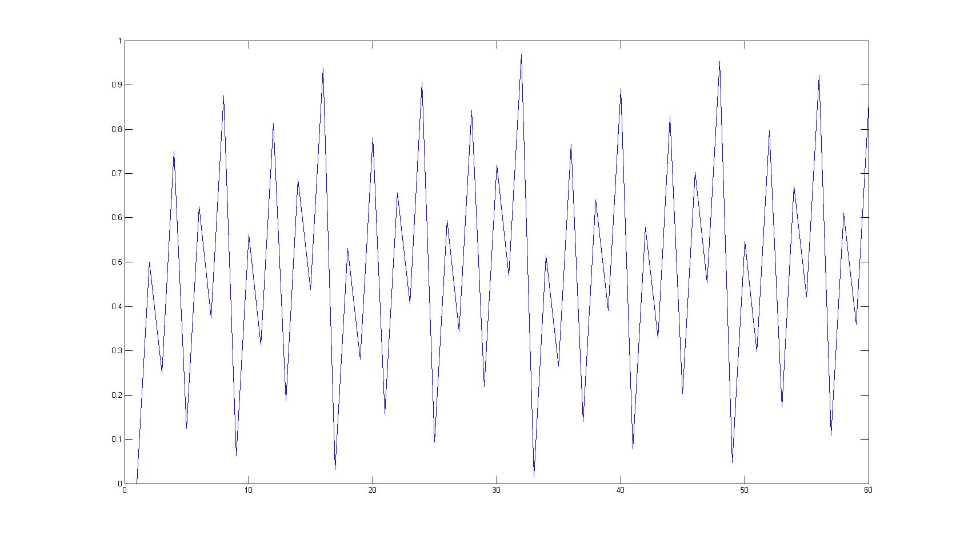
Van der Corput Sequence
Base 2 vs Base 10

Slide 12
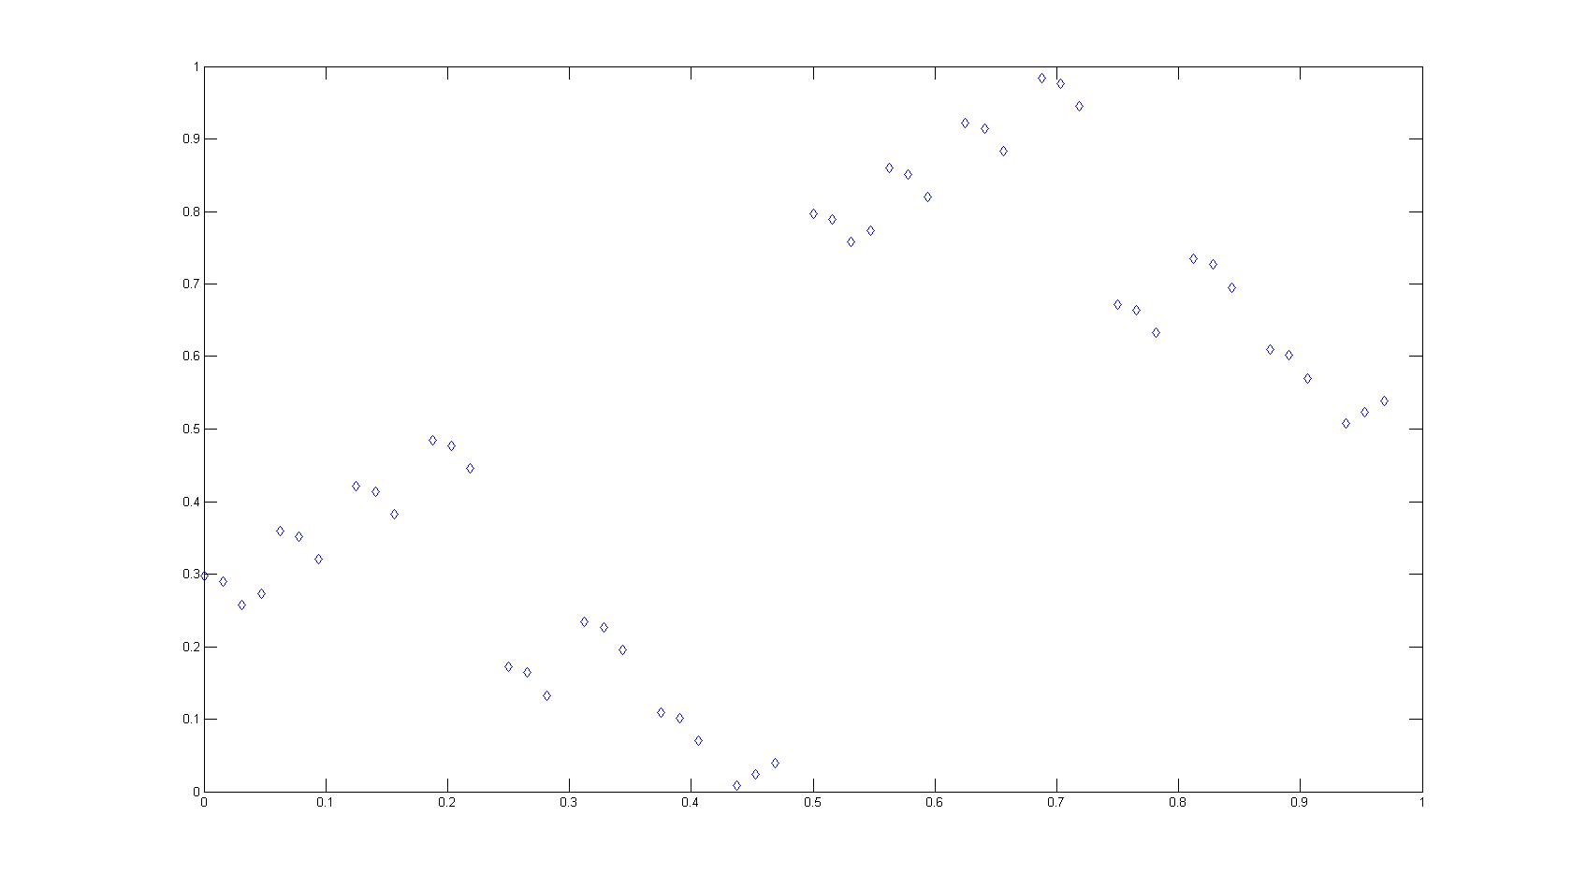
Van der Corput Sequence Base 2 (1-50) vs. Base 2 (51-100)

Slide 13
The Halton Sequence
The Halton sequence is an extension of the van der Corput sequence to higher dimensions
e.g.) 2 dimensions: the x-coordinates are the base 2 van der Corput number and the y-coordinates are the base 3 van der Corput numbers.

Slide 14
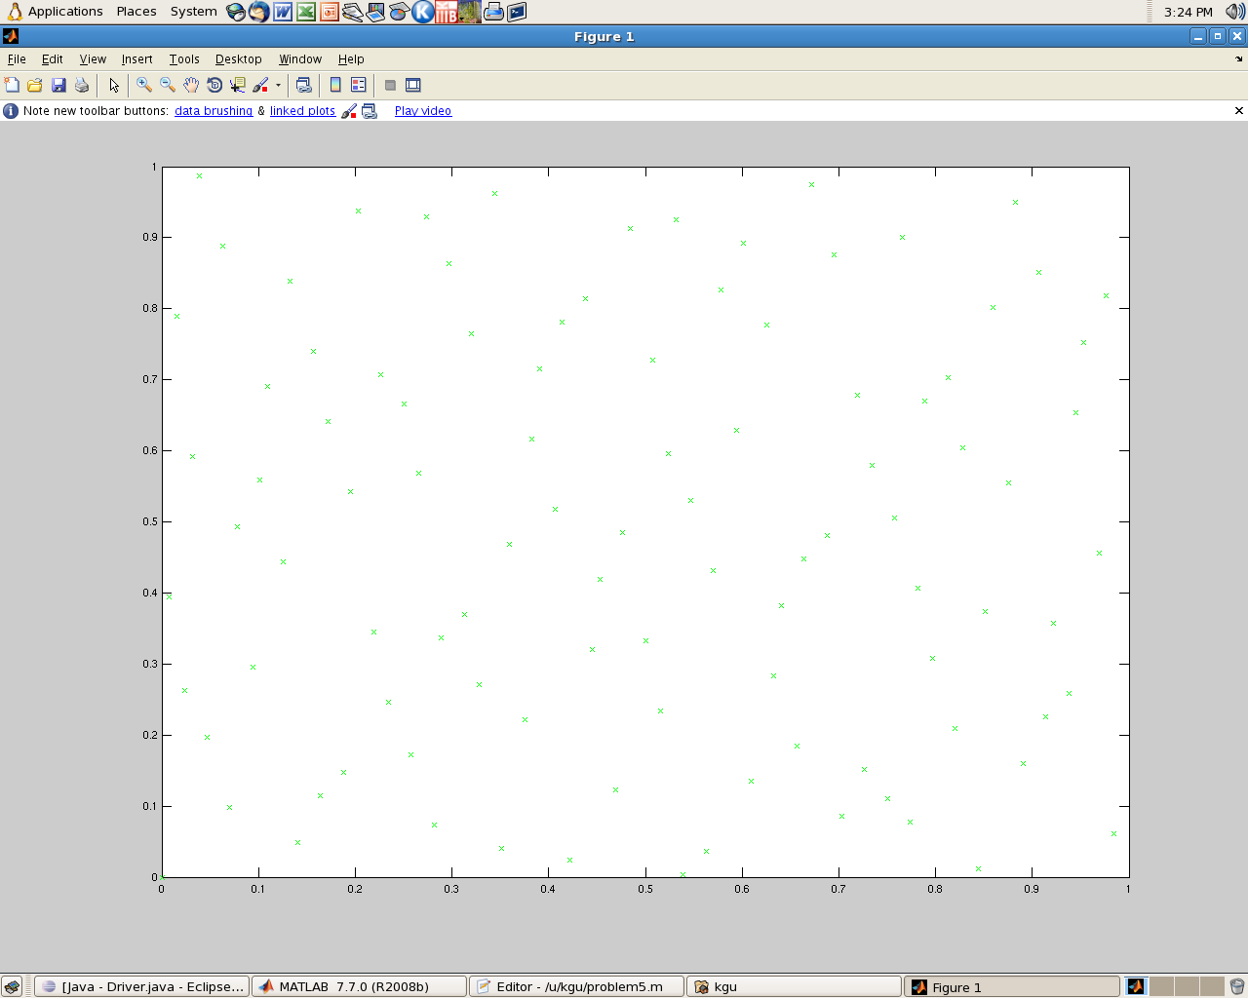
The first 100 Halton numbers
Number of dots in the circle: 79
Area Estimated:0.79
Ratio= 1.0059 %Error : 0.59% Compare to 5.78% error for random numbers generated by MATLAB

Slide 15
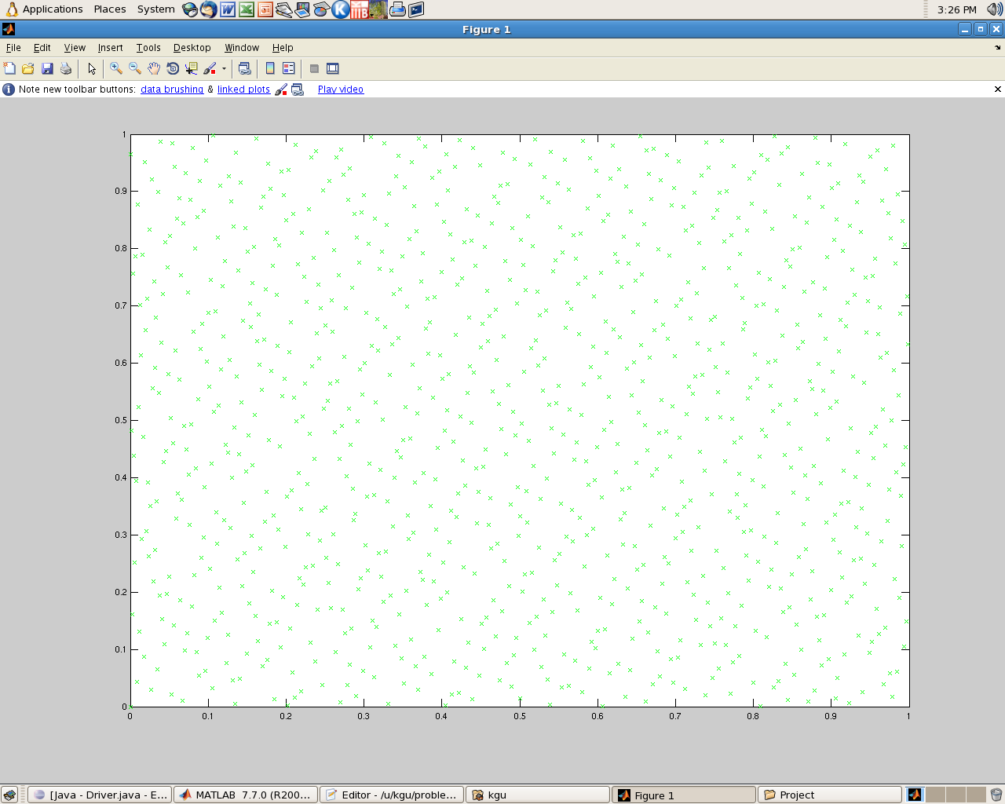
The first 1000 Halton numbers
Number of dots in the circle: 786
Area estimated: 0.786
Ratio: 1.0008 %Error : 0.08% Compare to 2.11% error for random numbers generated by MATLAB

Slide 16
Conclusion
Conclusion: Visually, the Halton sequence seems to be more uniformly distributed than the random numbers generated by MATLAB. The ratios also show that Halton sequence gives a better estimation of the area of the circle.

Slide 17
Calculating Discrepancy
To illustrate our observations mathematically, we can calculate the discrepancies of the different sequences.
D(Xi)= max_{B} |#(B,Xi)/N – Area(B)|
Where B is any rectangle, and #(B,Xi) is the number of points of the sequence before Xn that fall within the rectangle B. max (B) means that we want to find the maximum value we get over all possible choices of the rectangle B. Thus, the smaller the value of D, the closer the estimation is to real values, which means the numbers are more uniformly distributed.

Slide 18
Calculating Discrepancy
Examples
When Area (B) = 0.01
D (Halton base 2, 3)= 0.004
D (random)=0.01
When Area (B) = 0.0001
D (Halton base 2, 3)= 0.0019
D (random)=0.0029

Slide 19
Linear Congruence Generator
X_{n+1} = (Ax_{n} + B) mod M
Where A, B, X_{n} are matricies.
M (A, B) & (x_{n} = 0)
(1, 1) (1, 2) … (1, M-1) (1, 0)
(2, 1) (2, 2) … (2, M-1) (2, 0)
…
M = 7
7 7 7 7 7 7 1
3 3 3 3 3 3 1
6 6 6 6 6 6 1
3 3 3 3 3 3 1
6 6 6 6 6 6 1
2 2 2 2 2 2 1
1 1 1 1 1 1 1
M = 5
5 5 5 5 1
4 4 4 4 1
4 4 4 4 1
2 2 2 2 1
1 1 1 1 1
M = 3
3 3 1
2 2 1
1 1 1

